Slide 1


Psychographic Segmentation
Atish Kumar Majee (A22012)
Manas Kumar Sarkar (A22022)
Kishore Dipra Dutta (A22019)
Soumya Chatterjee (A22046)
Ashutosh Pandey (A22010)

Slide 2
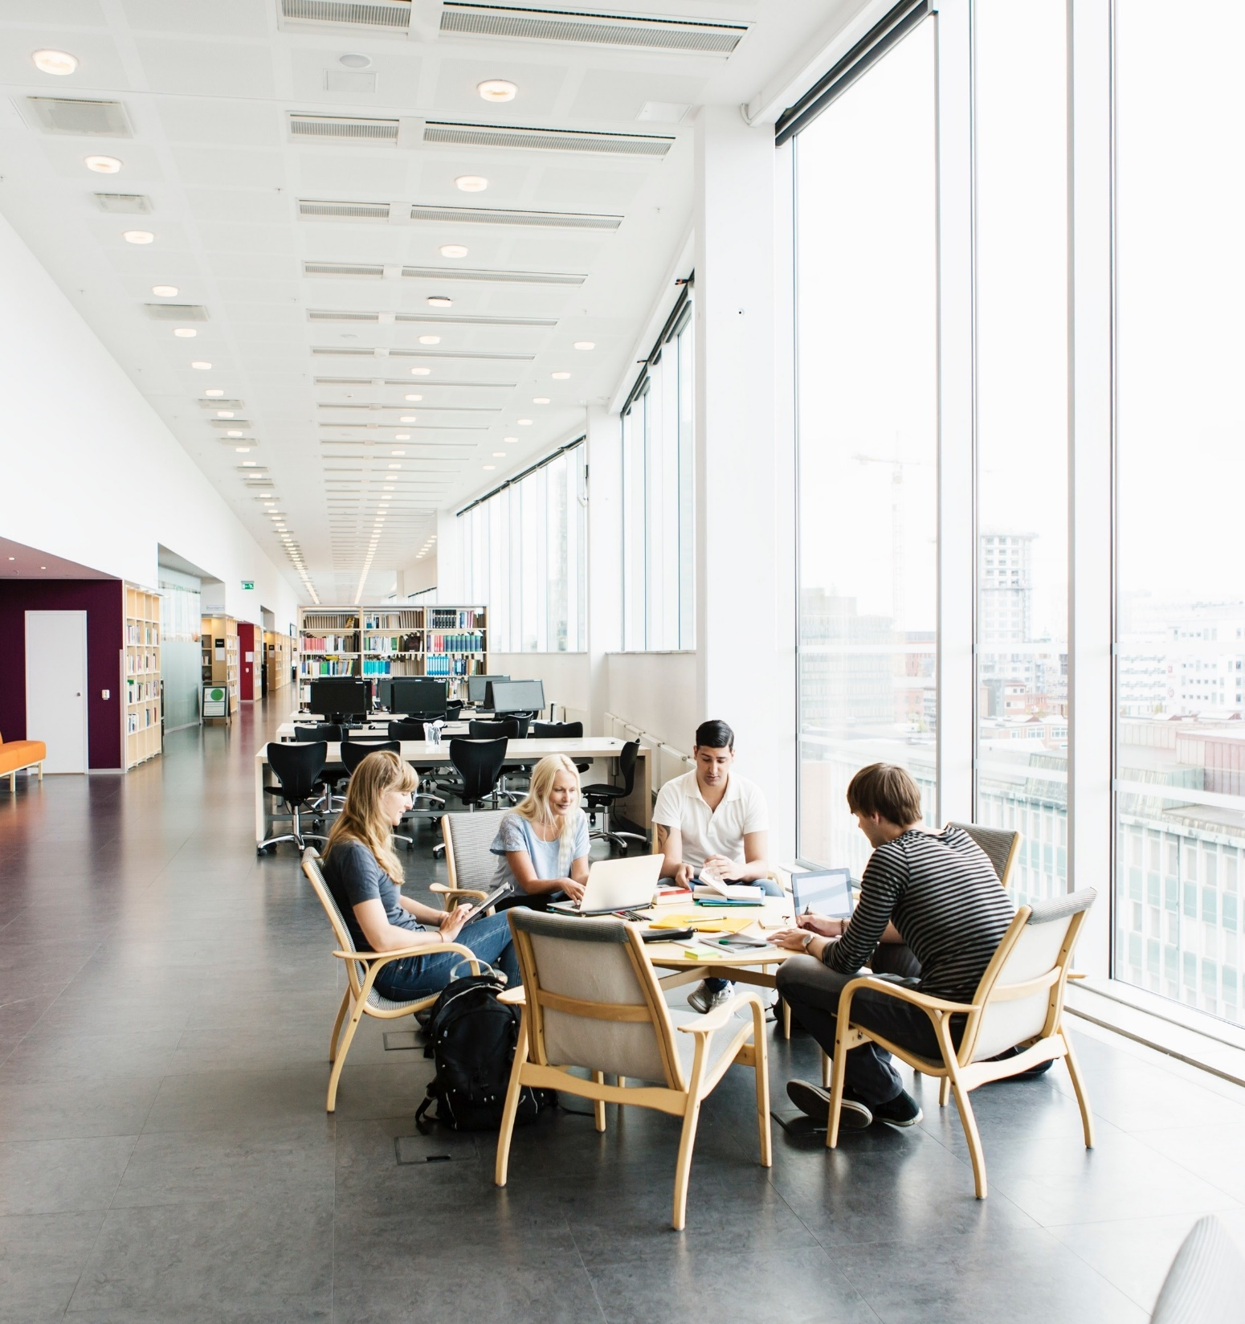
BACKGROUND & OBJECTIVES
Using a quantitative research survey among consumers, a certain number of psychographic statements were taken. The consumers were also asked about ownership and usage behavior of certain products. The primary objective of the study was to segment the target respondents by psychographics and then understand each segment by their usage of products. This research would give an understanding of the psychographics of users of some brands / product categories studied in this research. It could also give ideas for developing communication cues for other products and brands, for specific segments, in future.
2

Slide 3
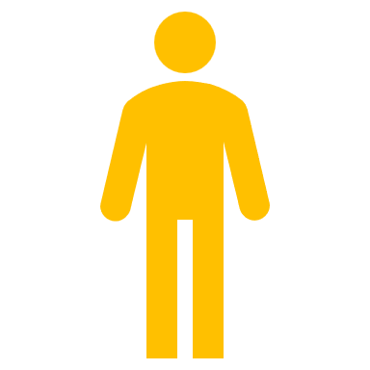

The Dataset:
Sample Size
1082
73.38%
26.62%
Sample by occupation
Student | 992
Working Executive | 88
Others | 1
Self Employed/business | 1
3

Slide 4
Cluster Segmentation
Cluster 3
Cluster 2
 | Clusters
 | 1 | 2 | 3
Size of cluster | 300 | 282 | 500
Percentage | 28% | 26% | 46%
Cluster 1
4

Slide 5
Normalized Table: Cluster Characteristics
Attributes | Cluster 1 | Cluster 2 | Cluster 3
I generally plan my expenses and never spend more than my budget | 1.248214 | -0.06671 | -1.1815
I often take opinions or check reviews before buying | 0.483881 | 0.279952 | -0.76383
I often experiment with new brands rather than just sticking to old ones | 0.218214 | 0.067286 | -0.2855
I like to spend my weekends with friends than staying at home . | -0.26579 | -0.42971 | 0.6955
My favorite subjects in school were Mathematics & Science rather than Literature | 0.844548 | -0.09538 | -0.74917
I make it a point to do some physical exercises (like swimming, walking, yoga) almost everyday | 2.569548 | -2.31538 | -0.25417
When I go out for shopping, I end up buying more items just by impulse | -0.97145 | 0.052619 | 0.918833
I am active on almost all Social media | -1.26279 | -0.11671 | 1.3795
I like light, sober colors to bright, exciting colors when it comes to clothing | 0.275548 | 0.202619 | -0.47817
I prefer watching videos/shows online rather than watching them in the television | -0.13045 | 0.521619 | -0.39117
I prefer ordering in from online apps than dining out | -0.89712 | 1.281952 | -0.38483
I follow Brands, celebrities, influencers on social media | -0.78579 | -0.74771 | 1.5335
I always try to keep up with new fashion trends | -0.29679 | -0.76071 | 1.0575
I prefer reading or listening to music rather than exercising or playing a sport | -1.02979 | 2.126286 | -1.0965

Slide 6
CLUSTER
CLUSTER 1
(METHODICAL)
CLUSTER 2
(HEEDFUL MUSICOPHILE)
CLUSTER 3
( INFLUENCER)
-Prefers Physical activities
-Pre-planned and pre-thought
-Makes Heedful decisions
-Loves Music
-Couch Potato
-Fashionista
-Unplanned
-Nethead
6

Slide 7


Cluster Distribution based on Gender, Age and Location
GENDER
AGE
LOCATION
C1
C2
C3
C1
C2
C3
C1
C2
C3
18-28: 83%
18-28: 85%
18-28: 91%
NORTH: 28%
NORTH: 24%
NORTH: 31%
75.00% 25.00%
69.52% 30.48%
77.81% 22.19%
SOUTH: 28%
SOUTH: 37%
SOUTH: 26%
29-40: 11%
29-40: 12%
29-40: 1%
EAST: 23%
EAST: 19%
EAST: 23%
40+ : 16%
40+ : 3%
40+ : 8%
WEST: 21%
WEST: 20%
WEST: 20%
7

Slide 8
Soft drink Preferences
8

Slide 9
Smartphones Usage
Apple
Xiaomi
Samsung
Vivo
Oppo
One Plus
Others
C1: 25%
C1: 26%
C1: 31%
C1: 26%
C1: 34%
C1: 29%
C1: 41%
C2: 15%
C2: 27%
C2: 31%
C2: 33%
C2: 19%
C2: 22%
C2: 29%
C3: 60%
C3: 47%
C3: 38%
C3: 41%
C3: 47%
C3: 49%
C3:31%

Slide 10
BRAND RECOMMENDATIONS
CLUSTER1
CLUSTER2
CLUSTER3
Sennheiser
JBL
Myntra
BIBA
HR-X
Nike
Reebok
10

Slide 11
CLUSTER MEMBERSHIP
CLUSTER1
CLUSTER2
CLUSTER3
ATISH KR MAJEE
MANAS KR SARKAR
SOUMYA CHATTERJEE
ASHUTOSH PANDEY
11

Slide 12


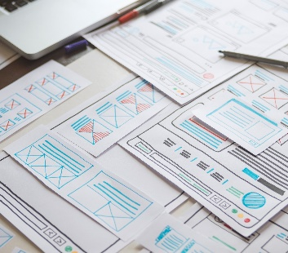
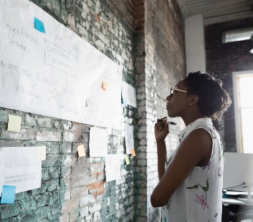
Thank you

